Slide 1
Towards A.T.E.N.A.: Deep Reinforcement Learning for Generalized Portfolio Management

Slide 2
TABLE OF CONTENTS
I
Supervised Learning
II
(Deep) Reinforcement Learning
III
A.T.E.N.A.
IV
Future Work

Slide 3
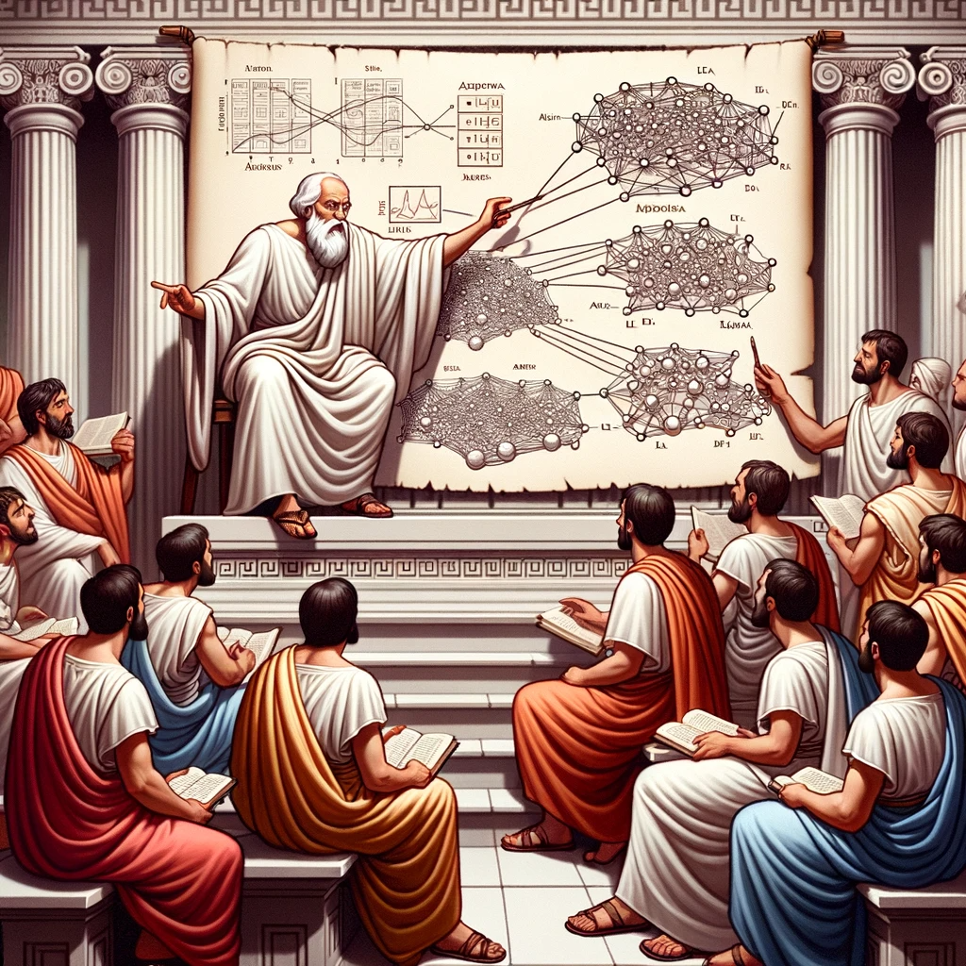
I
What is Machine Learning?

Slide 4
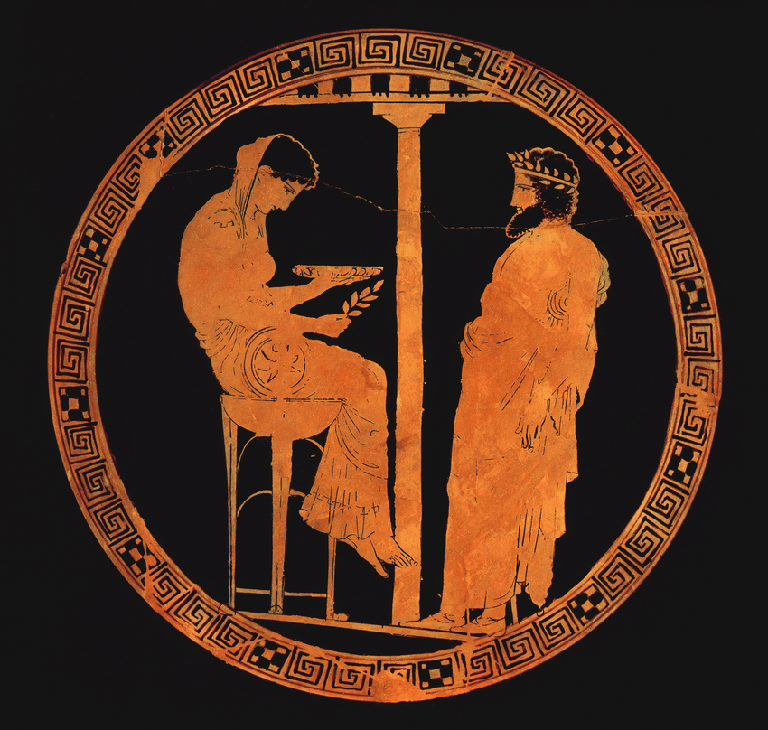
Ancient Greece: Pythia

Slide 5
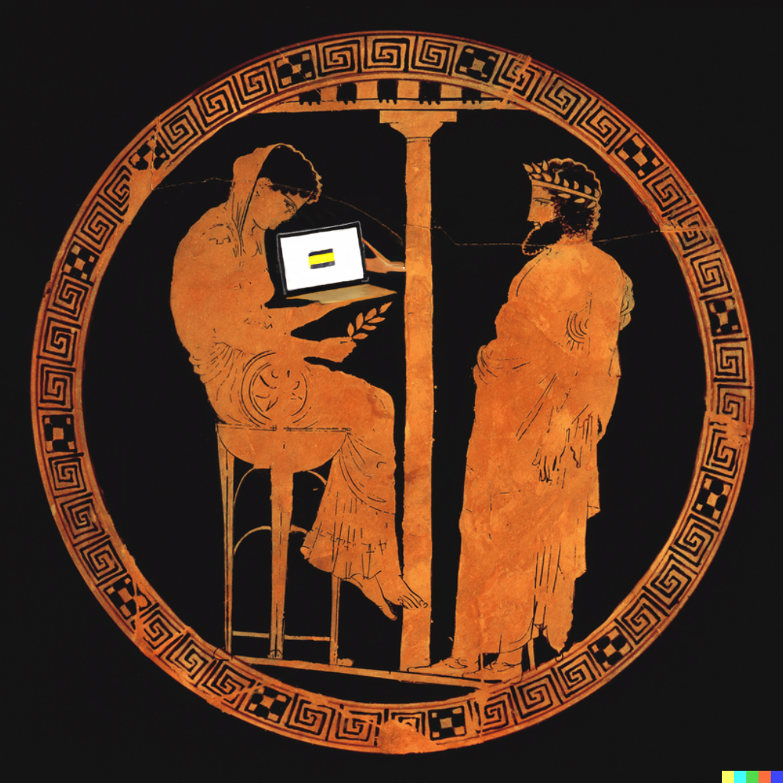
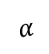
Let me check Python…
Ancient Greece: Pythia
Today:
Machine Learning?
$$α$$

Slide 6
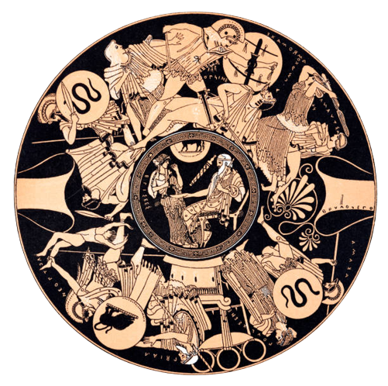
Supervised Learning: an example
Notes:
https://www.vhv.rs/viewpic/hJhRihw_neural-network-png-transparent-png/

Slide 7
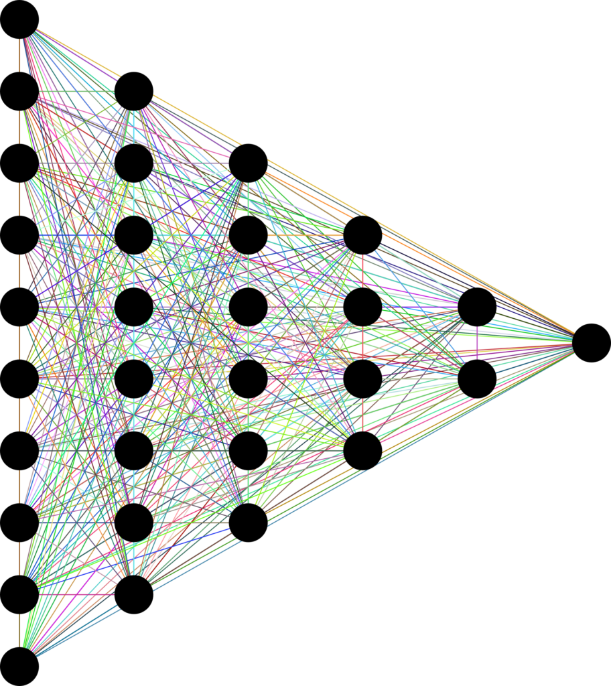
Predicting Battle Outcome
FEATURES
RESPONSE
#soldiers
Avg Age
#HEROS
…
WIN / LOSE
Notes:
https://www.vhv.rs/viewpic/hJhRihw_neural-network-png-transparent-png/

Slide 8
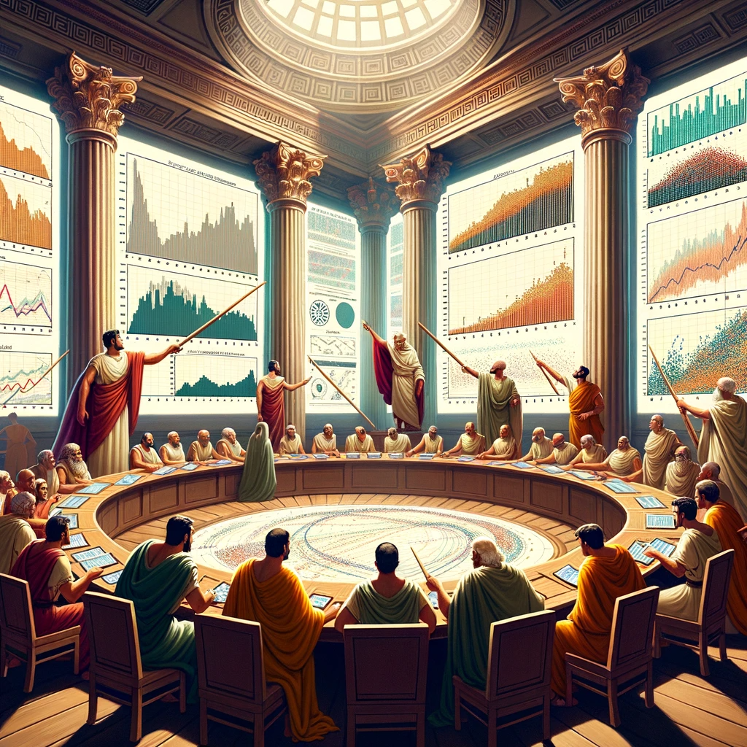
Predicting Battle Outcome
Notes:
https://www.vhv.rs/viewpic/hJhRihw_neural-network-png-transparent-png/

Slide 9
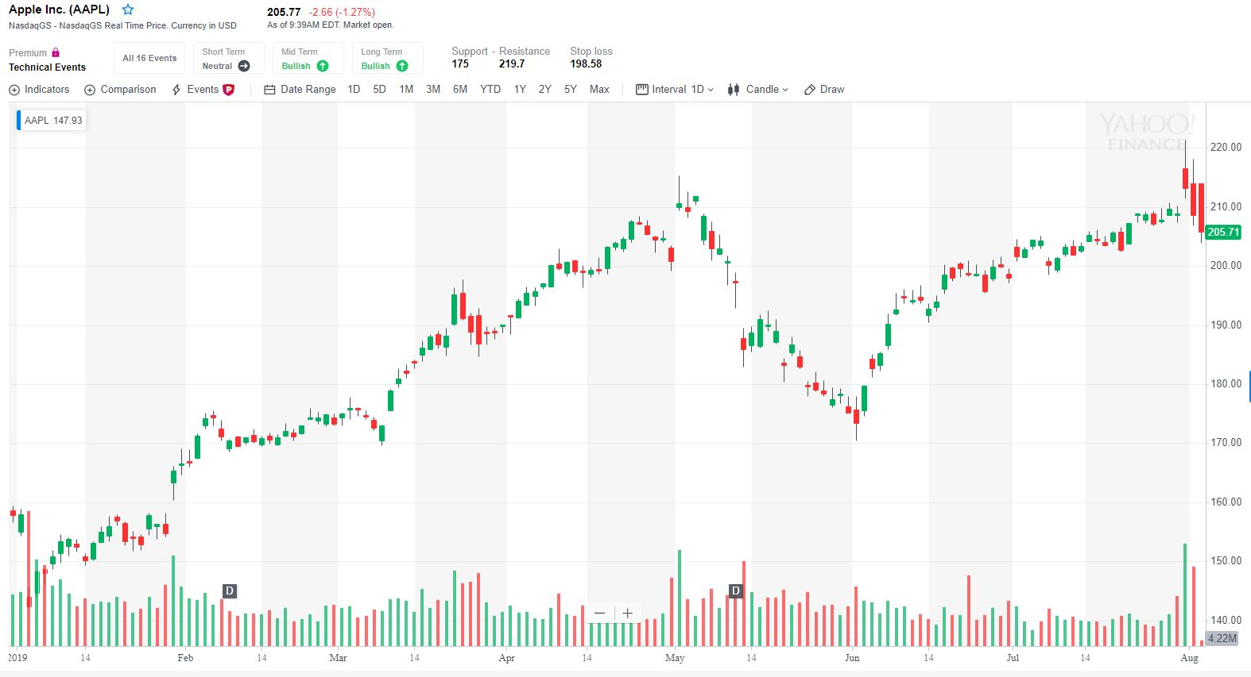
or…

Slide 10
Predicting the Stock Market
FEATURES
RESPONSE
Momentum
Value / Growth
Volume
…
(Low Frequency)
Up / Down
Empirical Asset Pricing via Machine Learning, The Review of Financial Studies, Gu et al., 2020

Slide 11
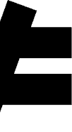
Action
Prediction
?
?
?
+1%
-4%
+3%

Slide 12
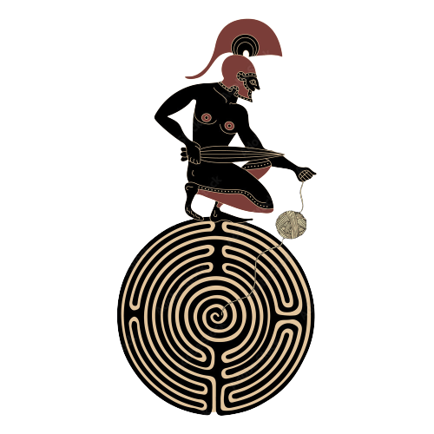
(Deep) Reinforcement learning
II

Slide 13
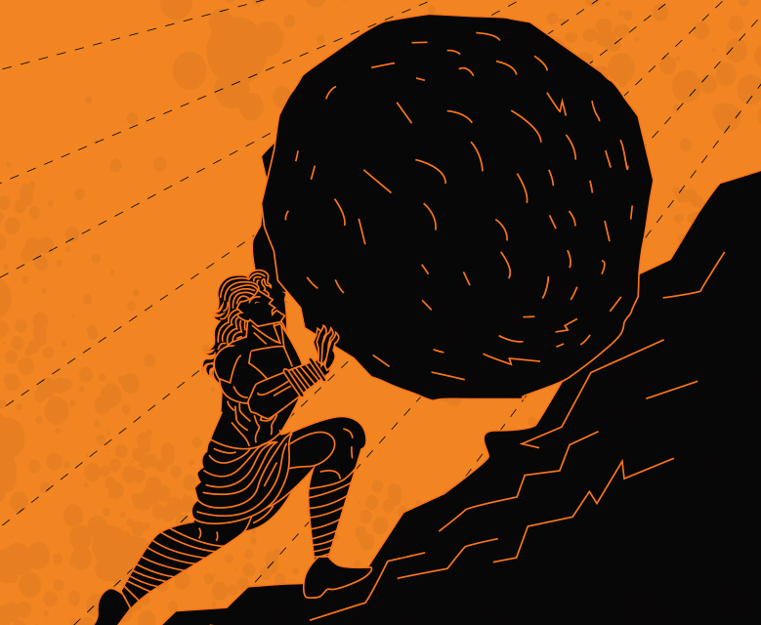

Similar to the myth of Sysyphus…

Slide 14
General Framework

Slide 15
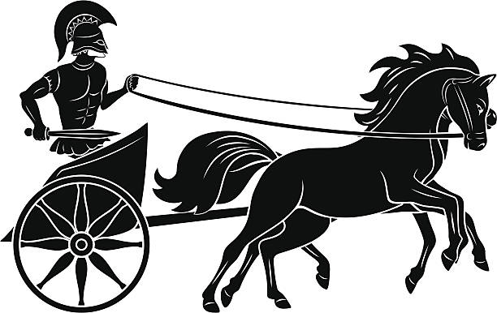
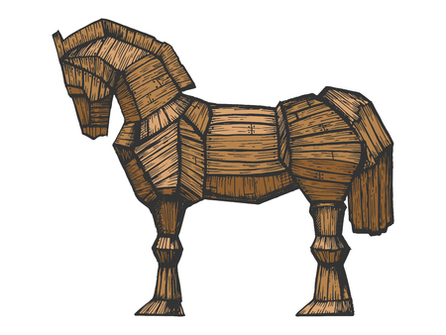
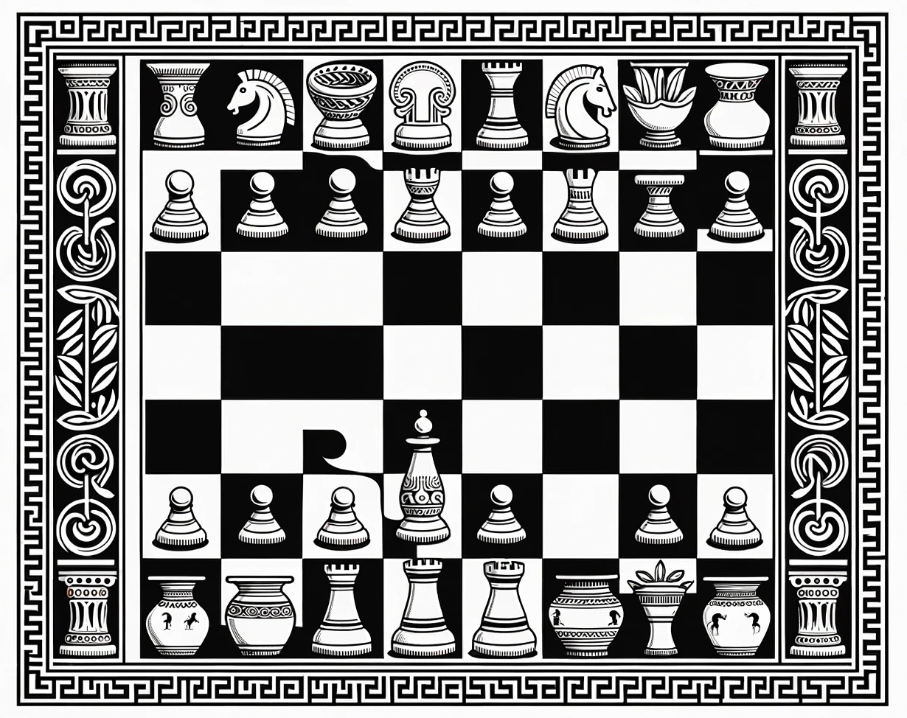
Transportation
Some RL Applications
Games
Robotics

Slide 16
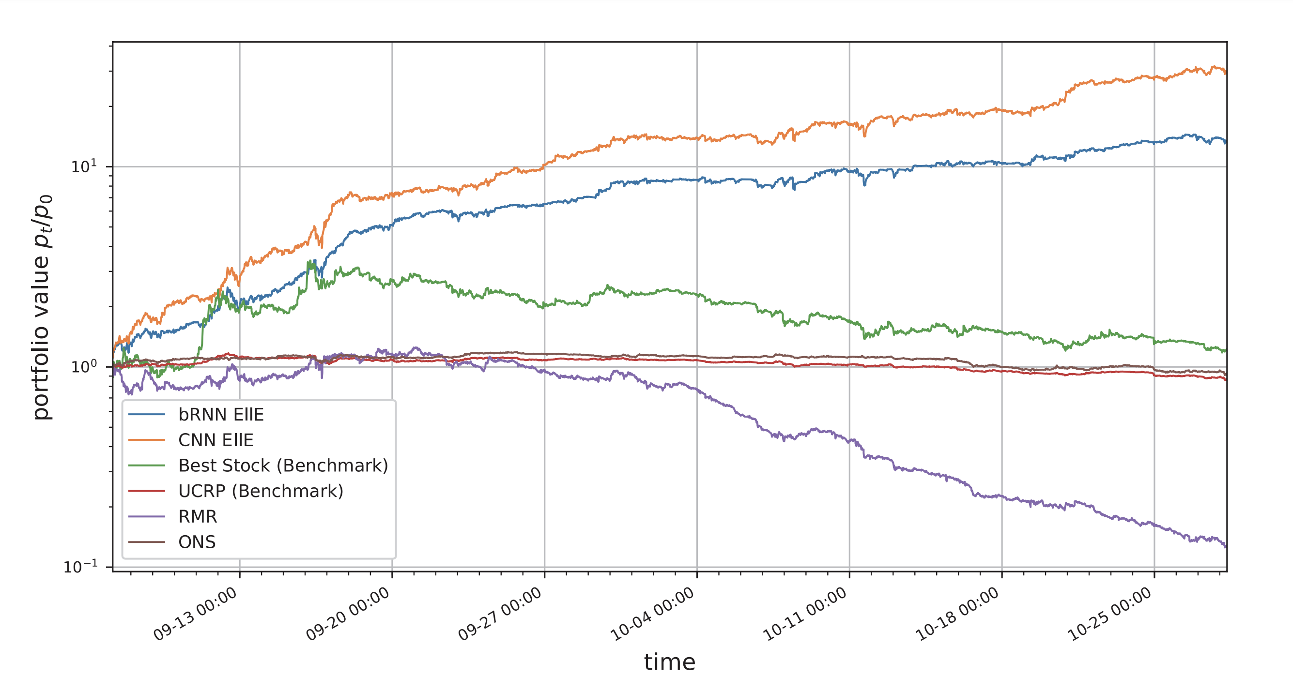
Portfolio Management
Source: Deep Reinforcement learning framework for the financial portfolio management problem (Jiang et al., 2017) (300+ citations)

Slide 17
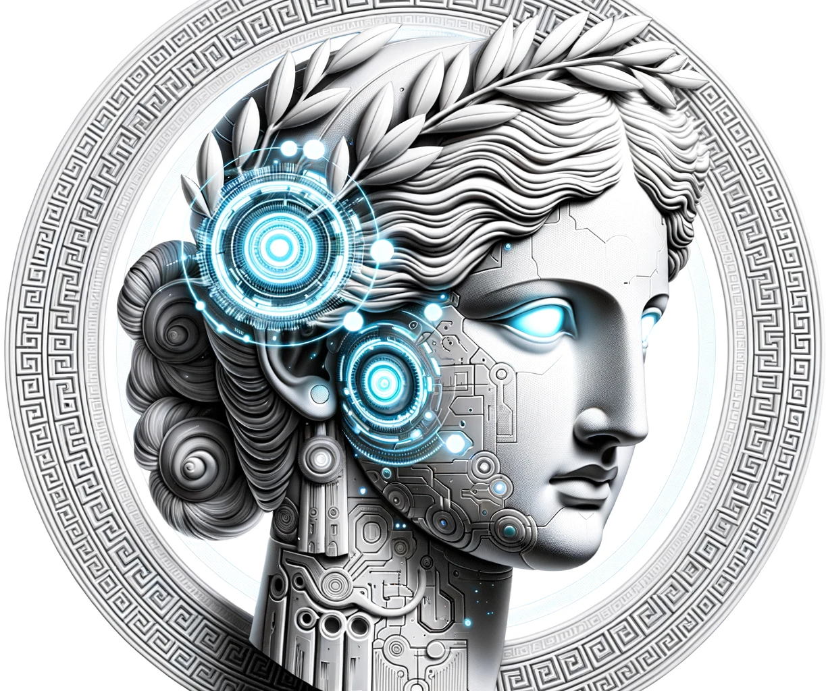
A.T.E.N.A. All-Trading Equity Neural Agent
III

Slide 18
A.T.E.N.A. All-Trading Equity Neural Agent
III

Slide 19

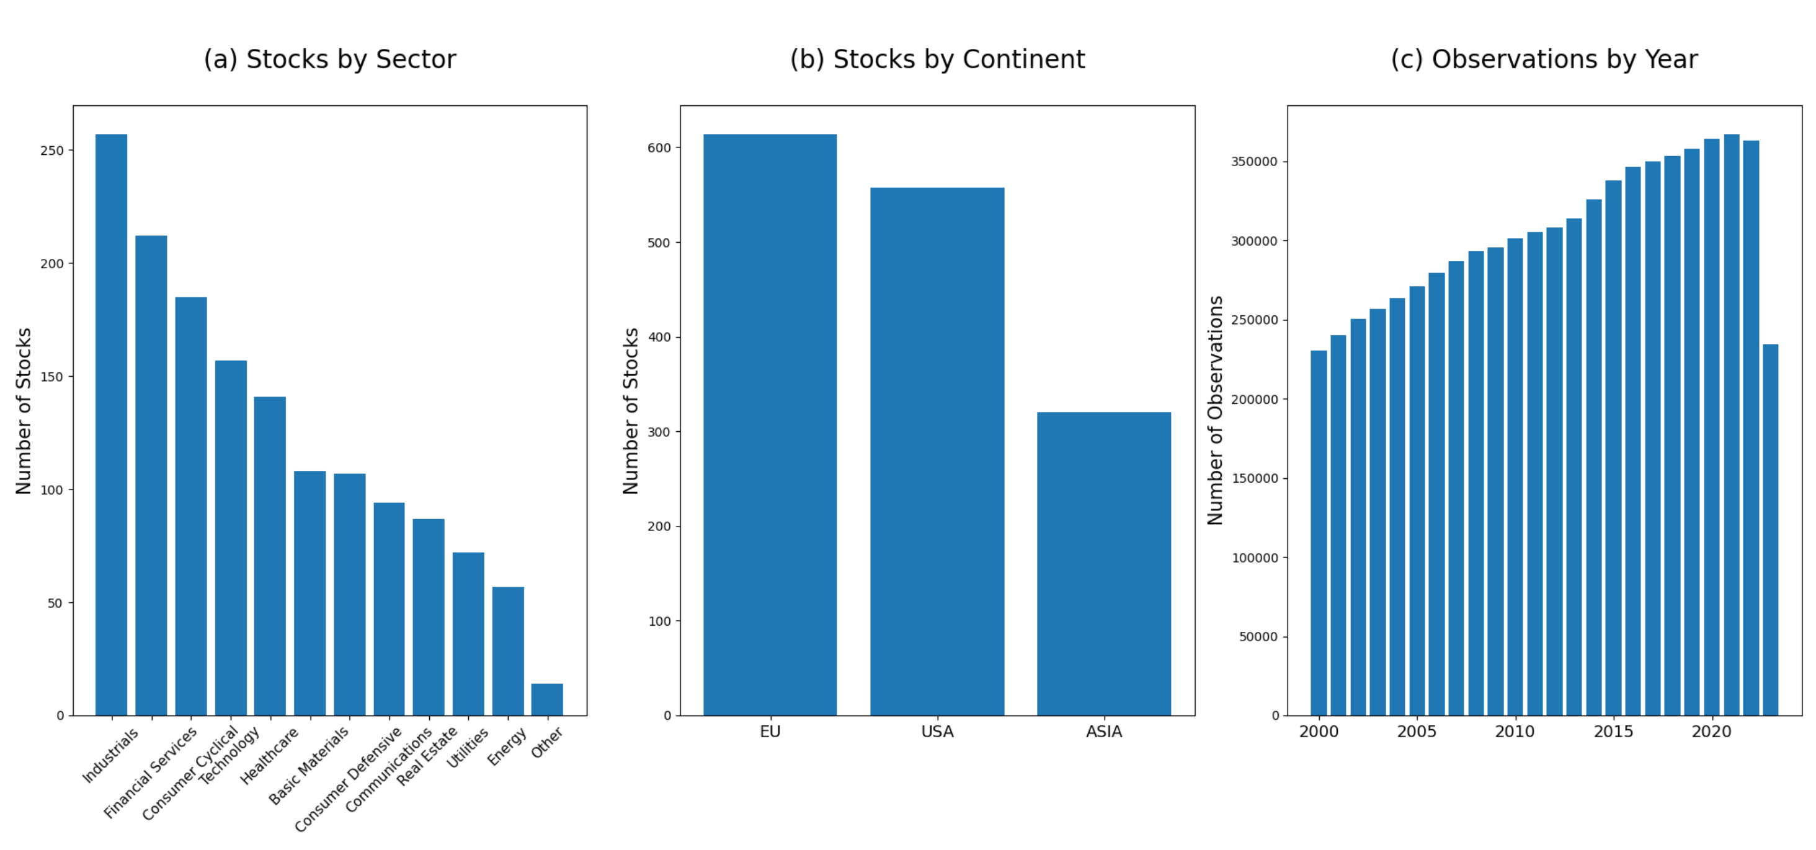
Stocks Data

Slide 20

Birth of A.T.E.N.A.
Sample 30 Stocks from a
pool of 1000+ stocks
Sample 5-year Trading Period from 2000 to 2020
Let agent trade and accumulate experience on the simulated period
Repeat (over 25’000 years of experience in total)

Slide 21
General Framework
A.T.E.N.A.
State
(e.g. recent stock returns)
New Portfolio allocation
Trading Environment
Reward
New
State

Slide 22
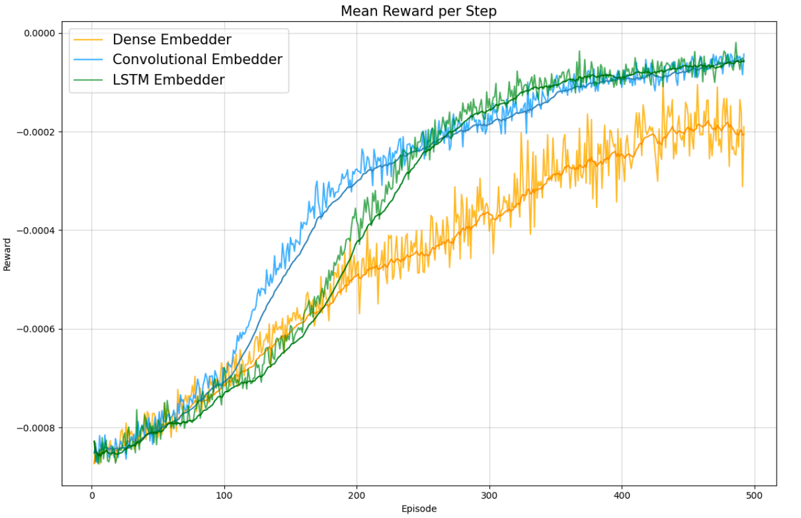
In-sample Learning

Slide 23
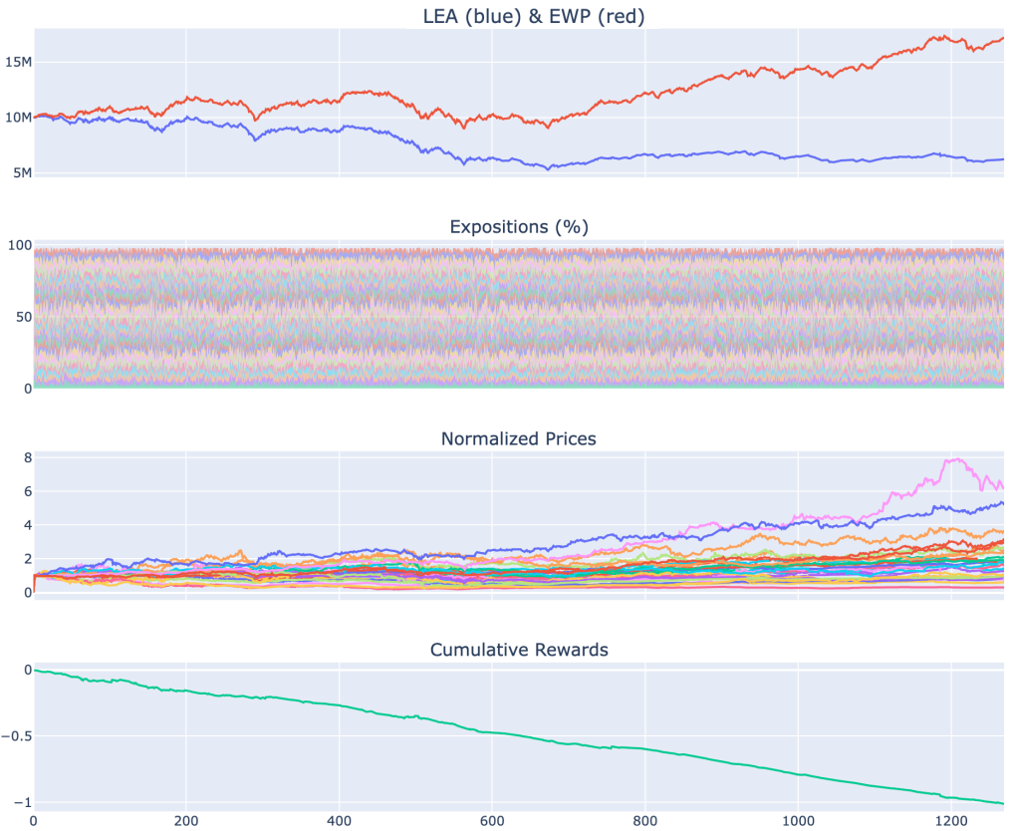
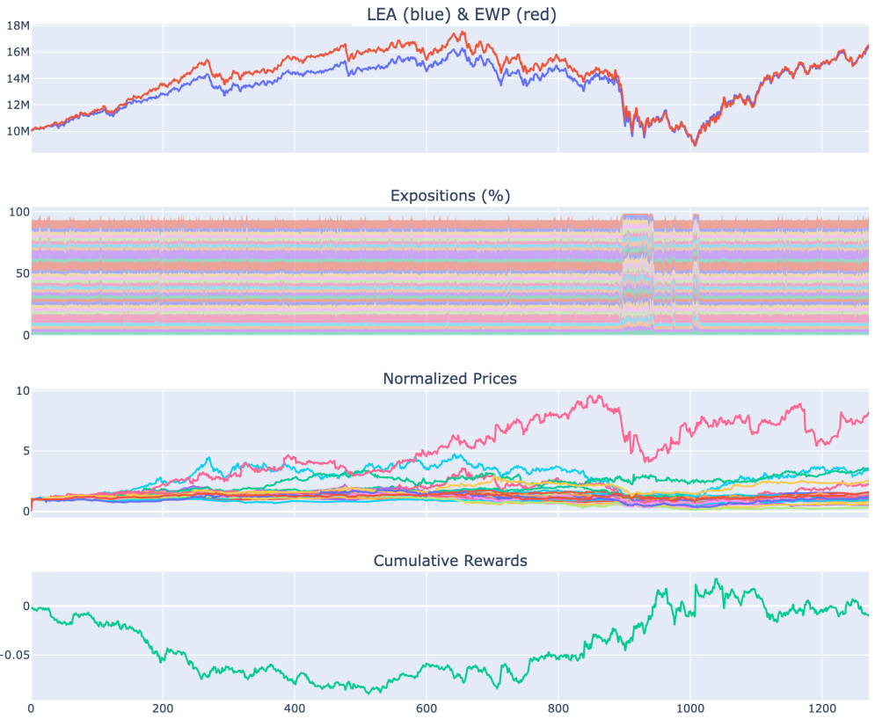
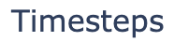
Early Episode
Late Episode

Slide 24
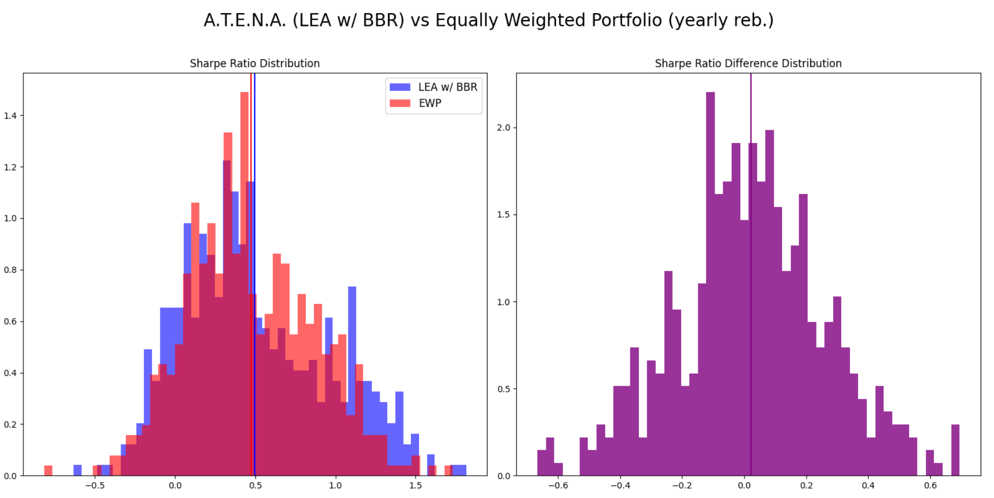
Out of Sample: Sharpe Ratio

Slide 25
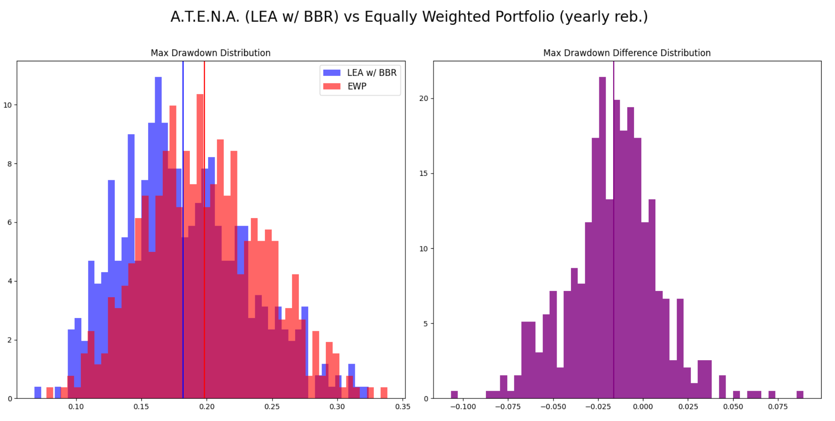
Out of Sample: Max Drawdown

Slide 26
IV
Future Work
Extend Training Dataset and Training time
Experiment with Transformers and recent deep learning advances
Test A.T.E.N.A.’s online learning capabilities
Compare Reinforcement Learning Algorithms (DDPG, A2C etc)

Slide 27
Thanks!

Slide 28
Appendix

Slide 29
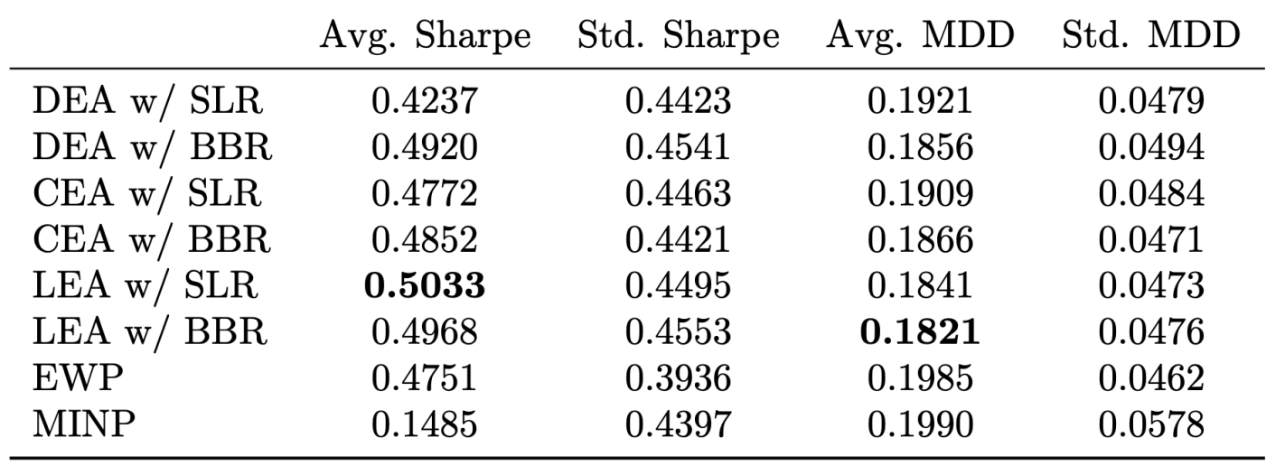
Out of Sample Performance

Slide 30
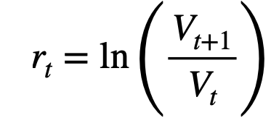
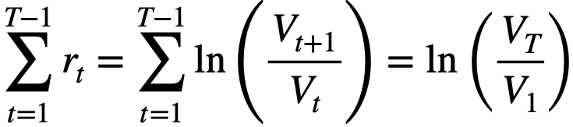
Simple Log Return Reward Mechanism
Reward per Timestep
Reward per Episode

Slide 31
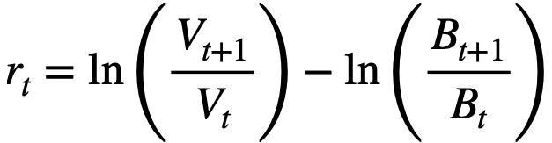
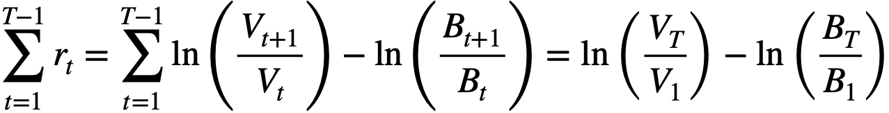
Beat the Benchmark Reward Mechanism
Reward per Timestep
Reward per Episode

Slide 32
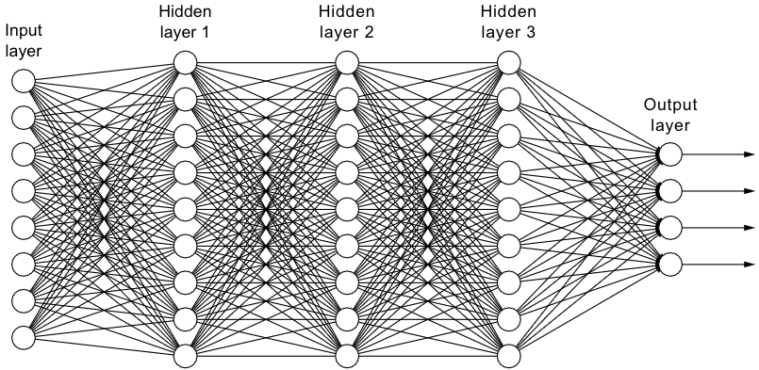


Neural Network Architectures
Dense NN:
Conv NN:
Recurrent NN:

